Slide 1
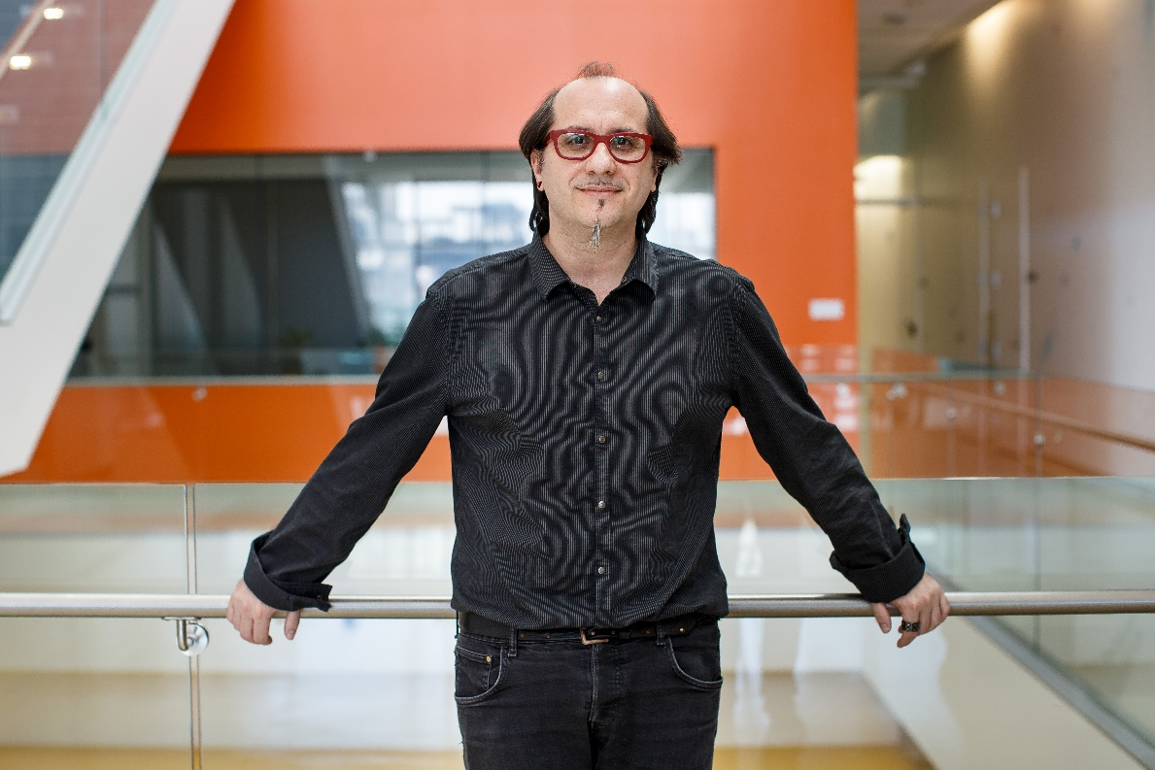
The Biological and Biomedical Joint Seminar Series
(Hosted by the departments of Molecular & Cellular Biology, Chemistry & Biochemistry, Cellular & Molecular Medicine, and Plant Sciences)
“Translating the cancer genome one codon at a time and its therapeutic implications”
Davide Ruggero, PhD
Professor, Urology
UCSF School of Medicine
Tuesday, March 13, 2018
ENR2 Room S107
Hosted By: Tim Bolger
To see all upcoming seminars, please visit mcb.arizona.edu/events or join the MCB Seminar Listserv (listname: mcbjointseminar) at list.arizona.edu.

